Slide 1


IPL Match Win Predictor
Dheeraj Chetti
Pradhyumna Chappidi
Koti Paruchuri
Amulya Patibandla

Slide 2
Problem overview
Cricket, especially the IPL has the maximum uncertainty where a single over can completely change the whole momentum and circumstances of the game.
Doing Sports analysis is the process of collecting past matches data and analyzing them to extract the essential and meaningful insights.
Using descriptive and inferential statistics, this dataset is a gold mine depending on how deep the analysis is done and on top of that the data of 2019 is also available.
Visualization of this dataset is the key part of our project as it cover lot of factors determining the winner of match.
As the IPL happens every year and is very popular in India therefore analysis
and finding insights can be very useful for future matches.

Slide 3
Introduction
The idea is to analyze the IPL data hosted by Kaggle to come up with something interesting and useful.
The insights from the dataset can really be helpful for the IPL management and team coach to improve themselves.
Handling all the factors like effect of home ground and toss winner is the real-world problem.

Slide 4
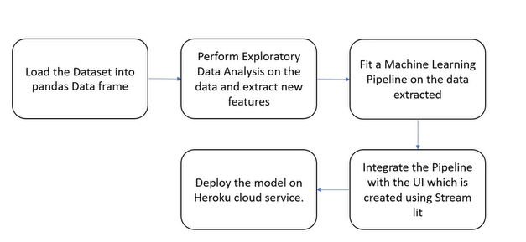
For the future progress, Machine Learning model can be applied to determine the probability of winning a match based on previous data.

Slide 5
About the dataset
The dataset was taken from the Kaggle and it contains the latest data of IPL 20.
The dataset has nearly 756 rows and 18 columns with some missing data and wrong data (which is mostly na values).
The dataset has detailed information about which team won the match by how much margin (wicket or runs depending on the team to opt for batting or bowling).
The dataset has columns telling about the man of match, venue, and the dataset was not sorted on the basis of season so sorting of data was done at beginning.
The column called Umpire3 in dataset was removed because more than 90% of data was missing.

Slide 6
Approach to problem
Predicting the winner of the next season of IPL based on past data can give us idea that which team has higher probability of winning the match which seems interesting.
As the dataset tell about the team, who won the toss along with the information of venue and man of match. The chances of winning the match by that team can also be determined on basis of these factor which is beneficial for sponsors and advertisement also.
As a cricket enthusiast, working on this dataset was fun and getting the insights was interesting.
Predicting the outcome of the match is a challenge but by means of inferential statistics and data visualization we can overcome the challenge to a certain extent.

Slide 7
Data Cleaning
In the Dataset there was lot of missing values in many rows and columns and cleaning the dataset is important to get graphs and insights without errors.
The matches where no result (maybe due to bad weather), the player of match and match-winner cannot be determined therefore data in those cells was filled with 'Not Possible'.
Missing data in the umpire column was replaced with the information present above the cell of missing data by the method of ‘ffill’.
In the city column the same city was written by two different names i.e some columns had Bangalore written in them and some have Bengaluru written.

Slide 8
DATA CLEANING
Changing the old team names to new team names
Considering the regular playing teams in each season
Removing the matches which got the result based on the DL method(match_df)

Slide 9
Data analysis
Grouping the 1st innings,2nd innings score in a particular matcheid.
capturing only the first innings,As we will be predicting for the second innnigs.
considering the 2nd innings :current score of particular match, runs left , balls left,wickets fallen , current run rate, required run rate.so we can predict win probability of the teams.

Slide 10
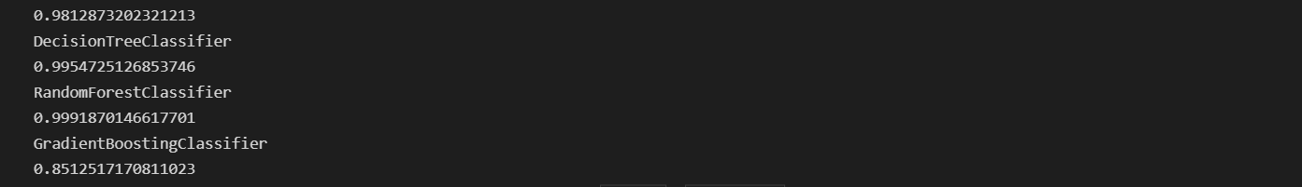
DATA MODELING
We tried the probability of different modelling techniques such as
LogisticRegression, KNeighborsClassifier, DecisonTreeClassifier, RandomForestclassifier, GradientBoostingClassifier.

Slide 11
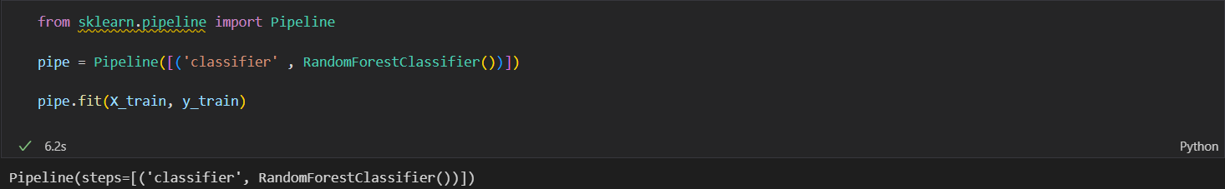
Data modelling
As RandomForest as highest probability we have chosen as our main model

Slide 12
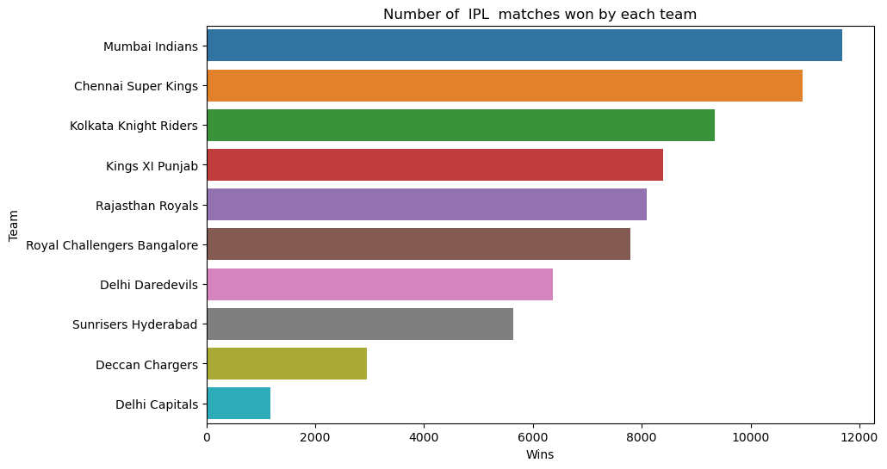
Visualization
This graphs gives information about the Number of IPL matches won by EachTeam. Mumbai Indians won the highest number of matches and then Chennai super kings.

Slide 13
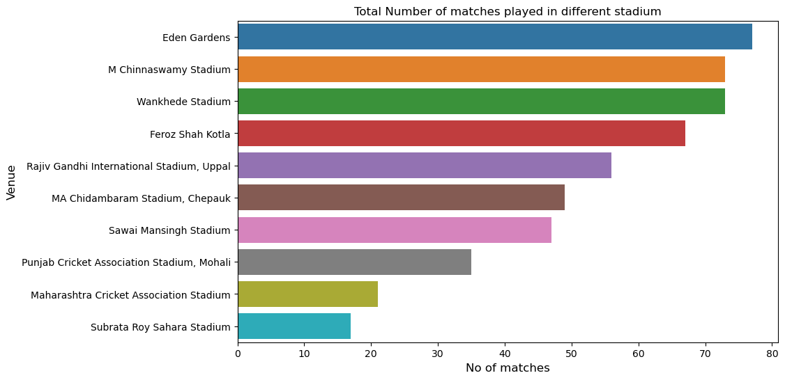
Visualization
This graphs gives information about Total Number of matches played in different stadium. Eden gardens hosted the highest number of matches.

Slide 14
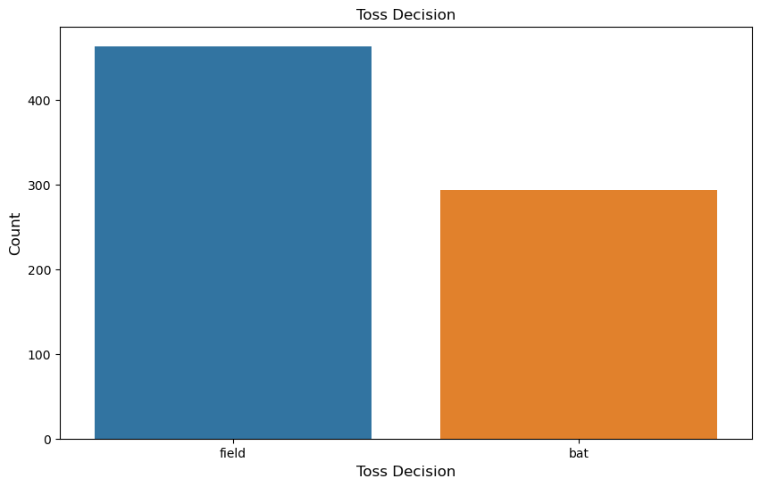
visualization
This graph gives information about Toss decision. Most of the teams choose to field after they won the toss.

Slide 15
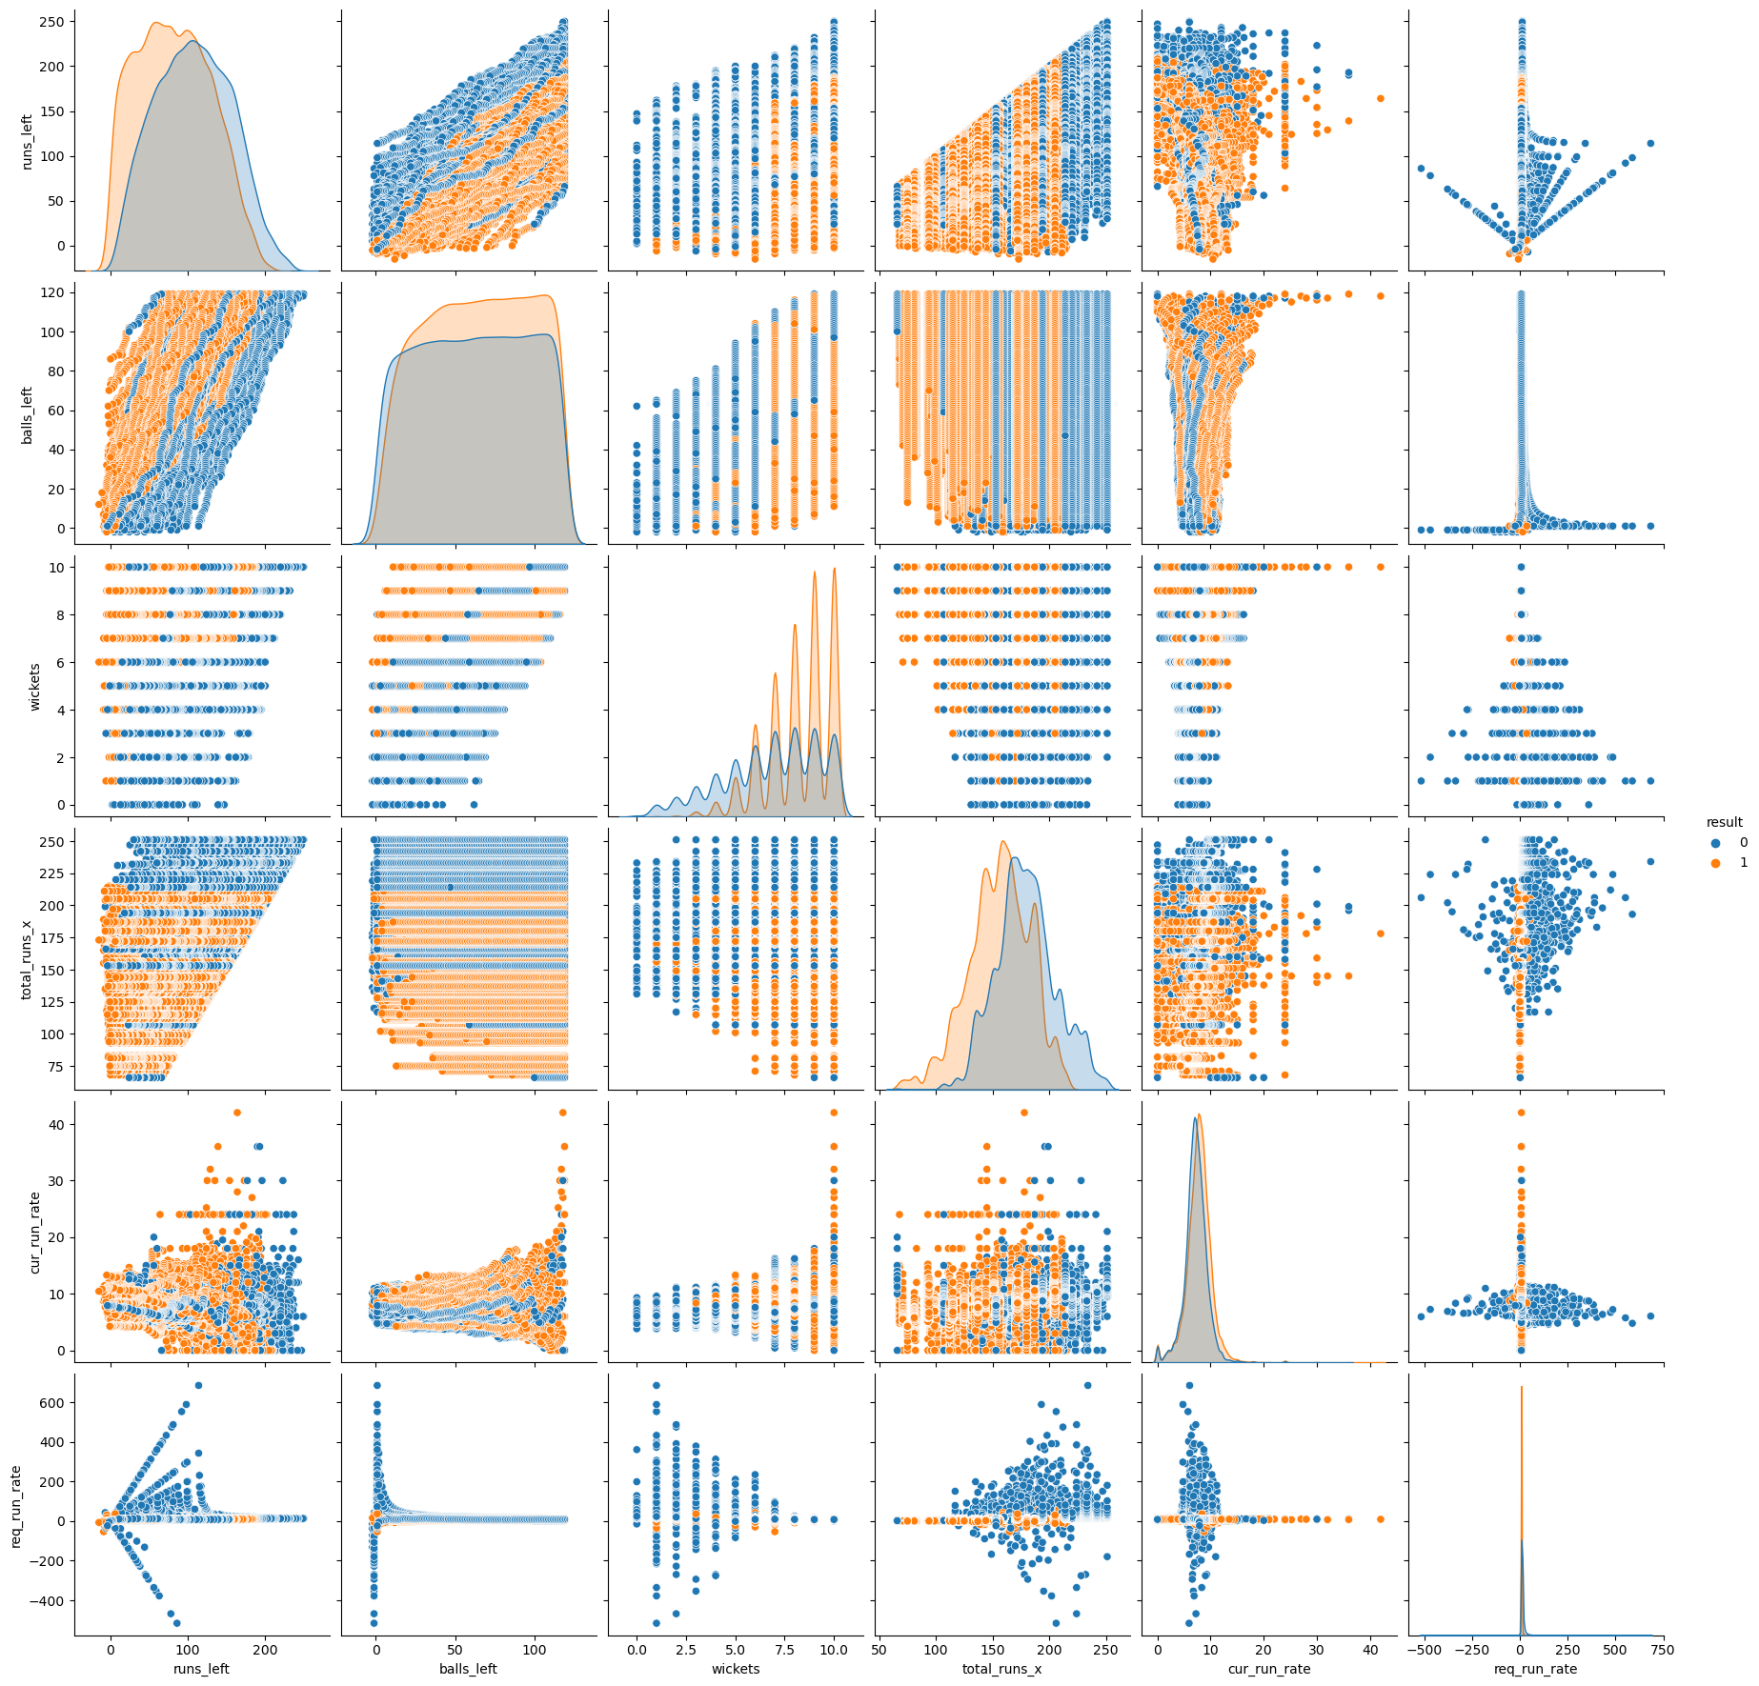
Visualization
This graph gives information about runs_left,balls_left,wickets,Total_runs vs Required run_rate and currrent_runrate

Slide 16
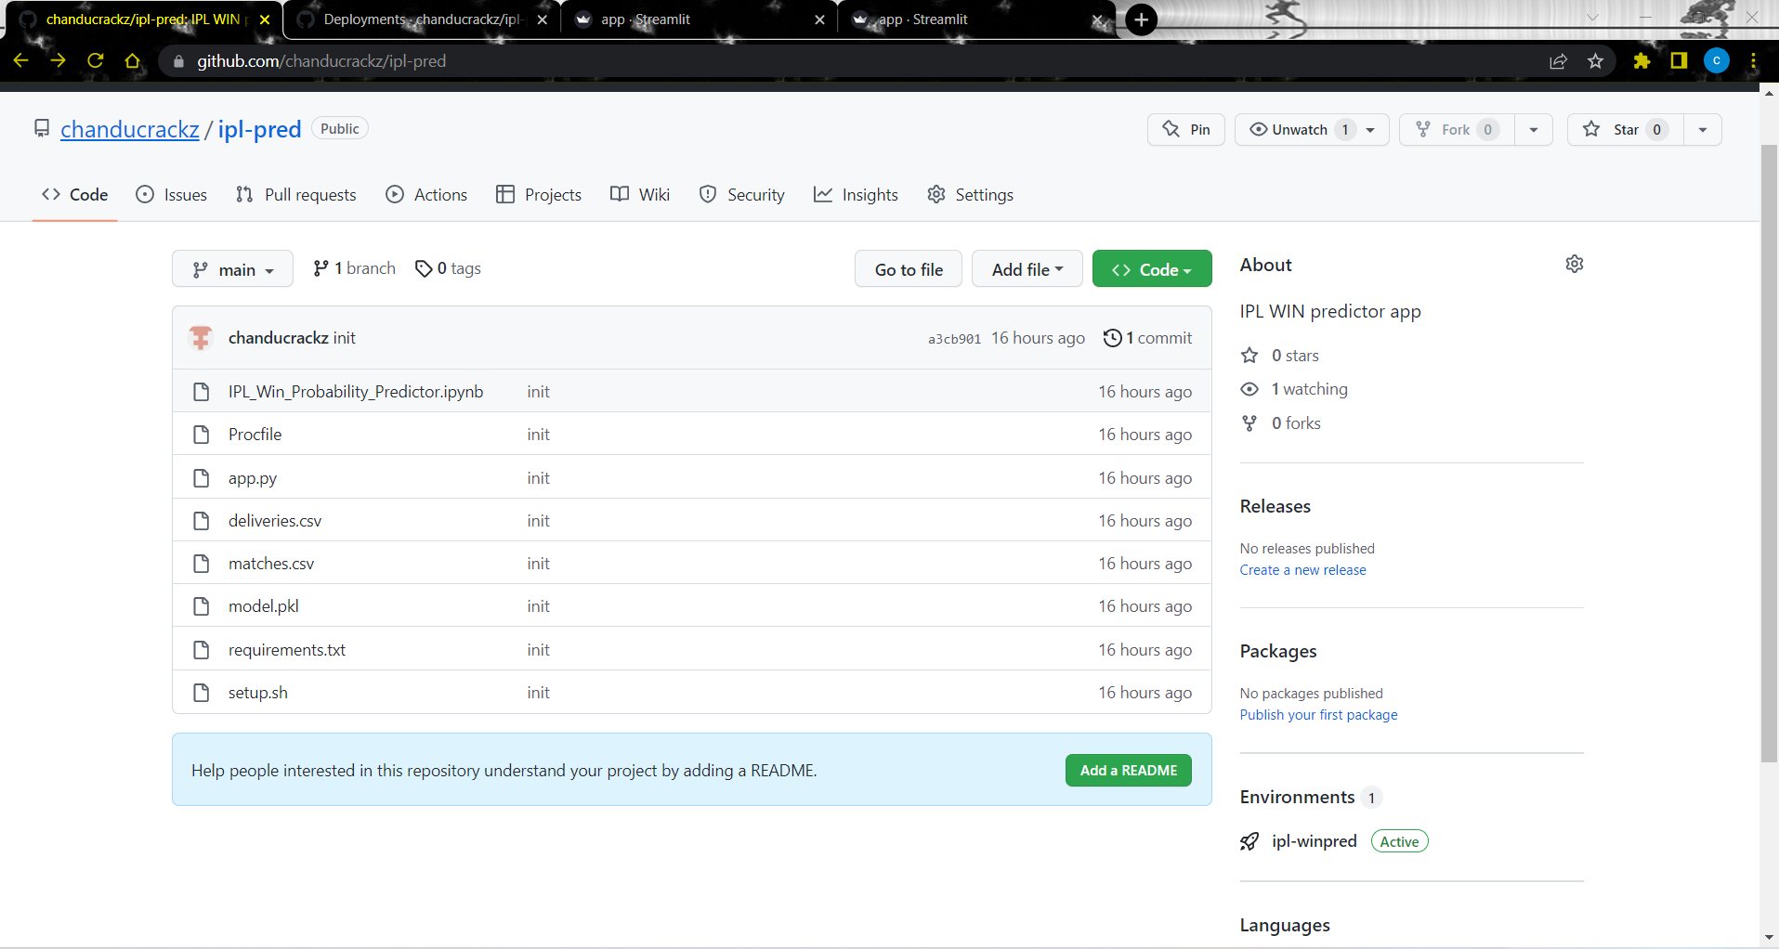
Deploy and maintenance
Github
As we push the code and datasets in to GITHUB .

Slide 17
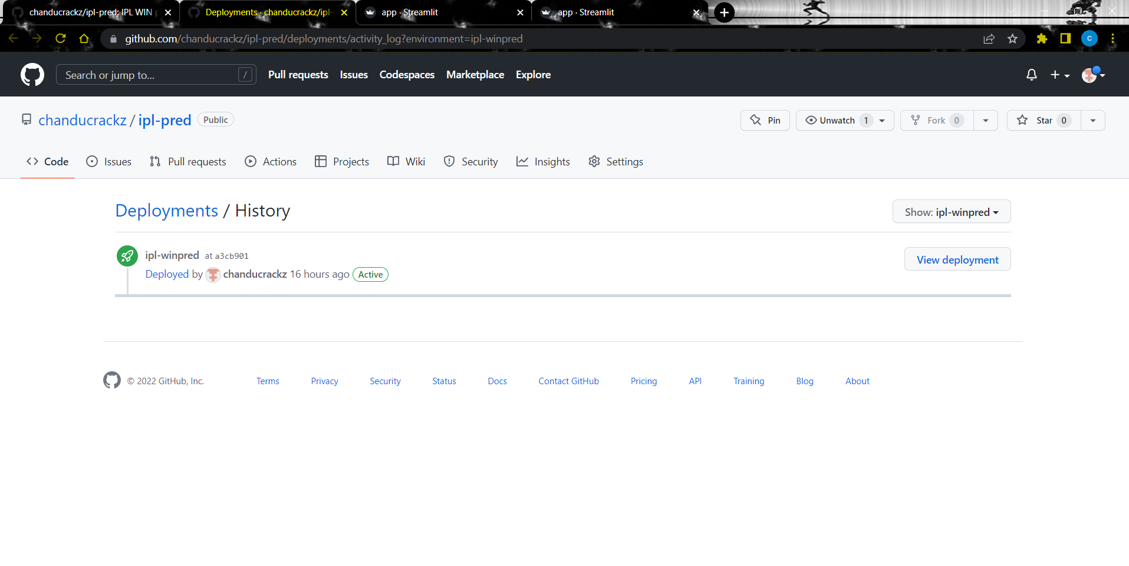
DEPLOYEMENT OF THE MODEL
And the model is ready for the DEPLOYEMENT in HEROKU:Cloud Application platform

Slide 18
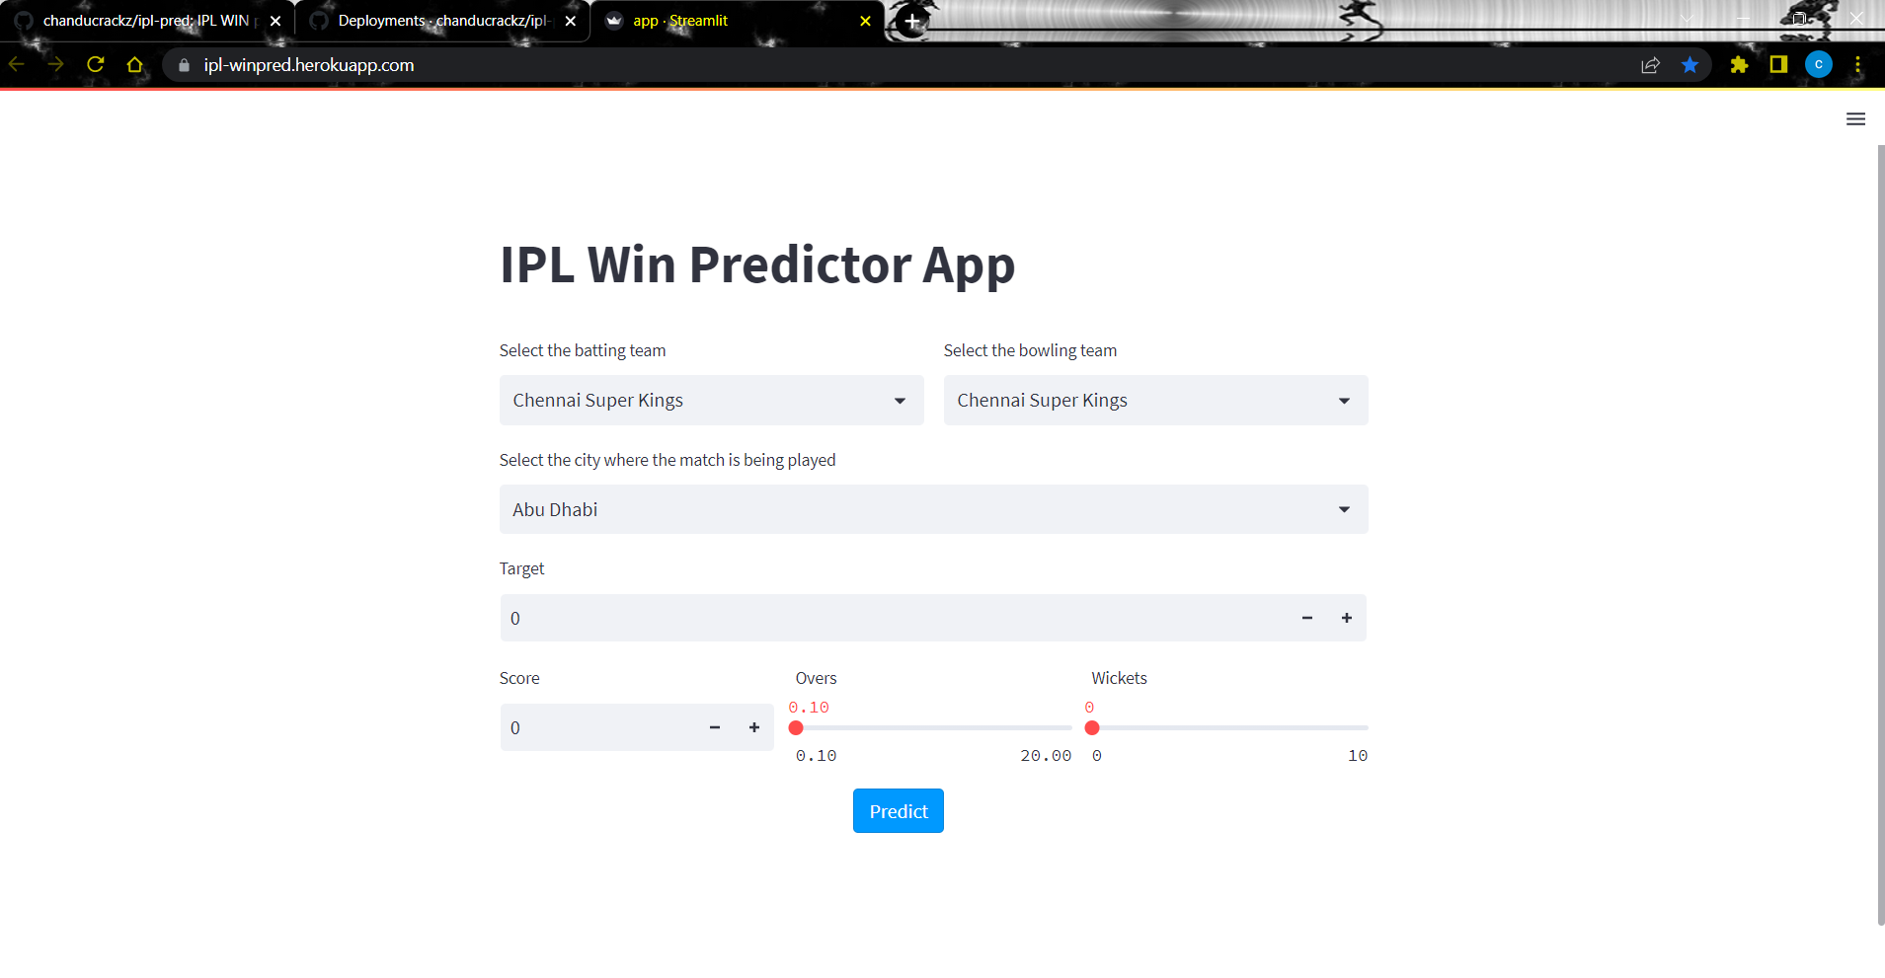
OUTPUT
This is outcome of our project where we choose the batting and bowling team and venue of the match. And we will give target, current Score, Overs, wickets fallen in second innings as the inputs.

Slide 19
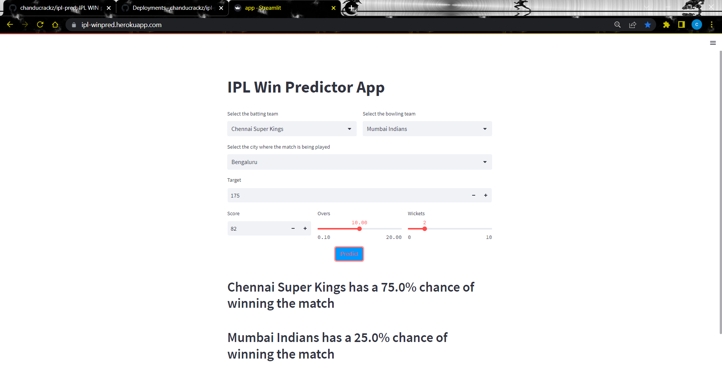
example
In this example Mumbai Indians scores 174.so175 Is the target for Chennai super kings and Chennai super kings current score is 82 per 2 After10 overs. Our model predicts Chennai Superkings has a 75% chance of winning the match and Mumbai Indians has a 25% chance of winning the match.

Slide 20
Conclusions
From the analysis, it was concluded that Chennai Super Kings and Mumbai Indians are more likely to win upcoming IPL seasons.
Kolkata, Bangalore and Delhi is more likely to have bad weather during the IPL season.
Teams have won more matches in their home grounds.
M Chinnaswamy stadium and Eden Gardens is best Suited for Feilding and MA Chidambaram Stadium, Chepauk is best suited for Batting.
At Mumbai highest number of matches has been played.
Chris Gayle has most title for man of the matches i.e 21.
Delhi Capitals has more chances of winning the toss followed by Deccan Chargers but Delhi Capitals has played only two seasons.
There is no linear relation between win_by_runs and win_by_wicket as correlation coefficient is negative.

Slide 21
Totally 13 teams has participated in IPL History and few teams like: Pune Warriors, Kochi Tuskers Kerala, Rising Pune Supergiants, Gujarat Lions and Delhi Capitals has been only in 2 seasons and their success rate of is good when compared to other teams.
Mumbai Indians, Royal Challengers Bangalore and Chennai Super kings are best Defending teams.
Royal Challengers Bangalore, Mumbai Indians and Kolkata Knight Riders are the best Chasing teams.
From the year 2014 most of the teams are opting to field after winning toss and are also successful in winning the match.
Overall Chennai Super Kings and Mumbai Indians have high success rate and these two teams are the most successful teams as CSK has won 4 seasons and MI has won 3 seasons.

Slide 22
THANK YOU

